Slide 1
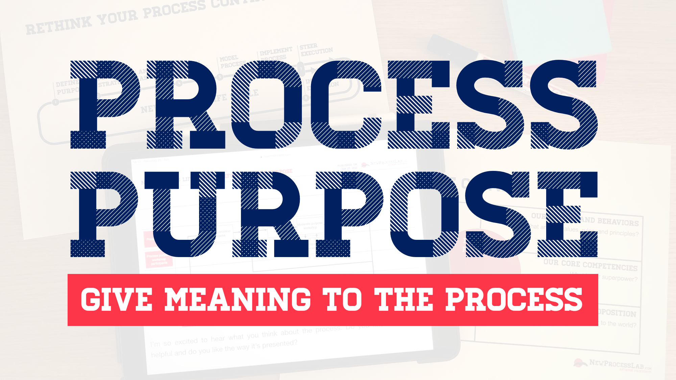

Slide 2


Slide 3
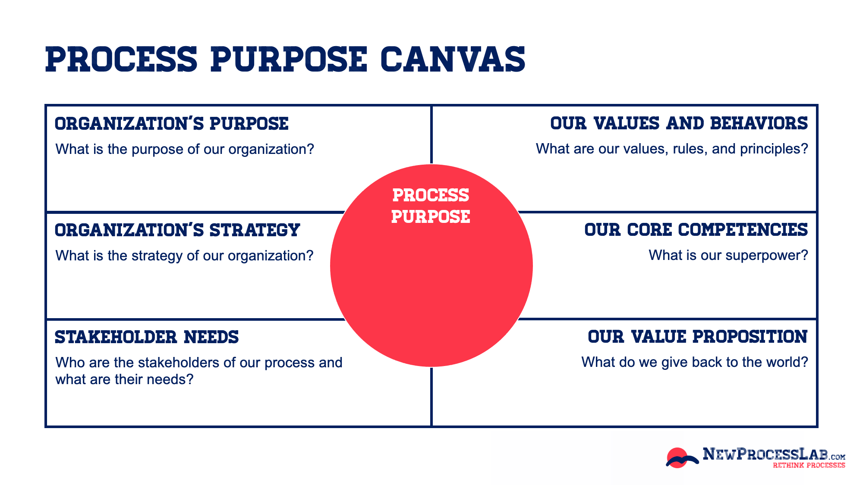

Slide 4
Your Process Purpose
...
…
…
…
…
…
…

Slide 5
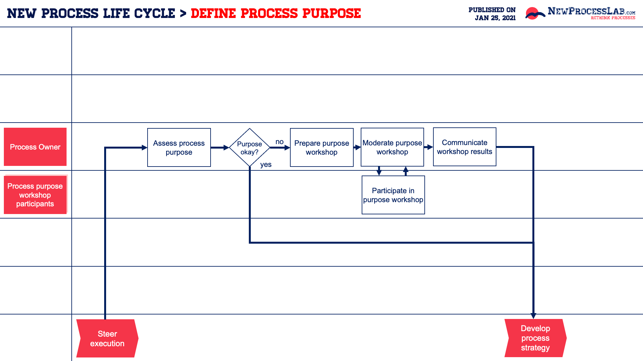
Visit https://newprocesslab.com/toolbox/define-process-purpose/ for more details!
Notes:
https://newprocesslab.com/toolbox/define-process-purpose/

Slide 6
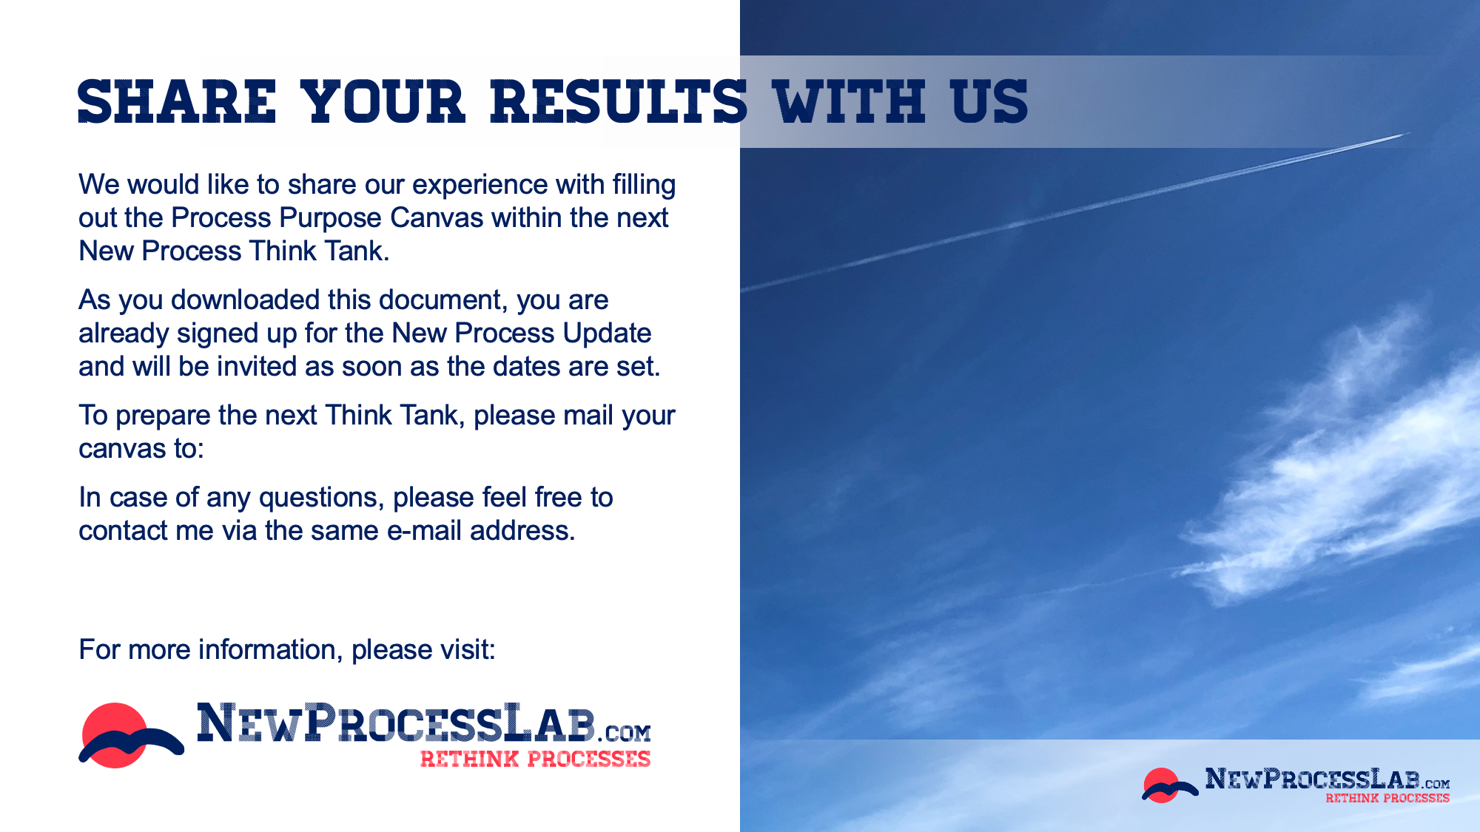
Mirko@NewProcessLab.com

